Slide 1
Compiler Construction
Teacher : Zulfiqar Ali
Email: Zulfiqar.rafique@nu.edu.pk
Office: No.6,Basement -1 (CS Block 1)

Slide 2
Week 6:
Recursive Decent Parsing
Non-Recursive Descent Parser - LL(1) Parser

Slide 3
Recursive Descent Parser
A recursive descent parser is a top-down parser
It processes input based on a set of recursive functions.
Where each function corresponds to a grammar rule.
It parses the input from left to right, constructing a parse tree by matching the grammar's production rules.
This parser is simple to implement and is suitable for LL(1) grammars.
where decisions can be made based on a single lookahead token.

Slide 4
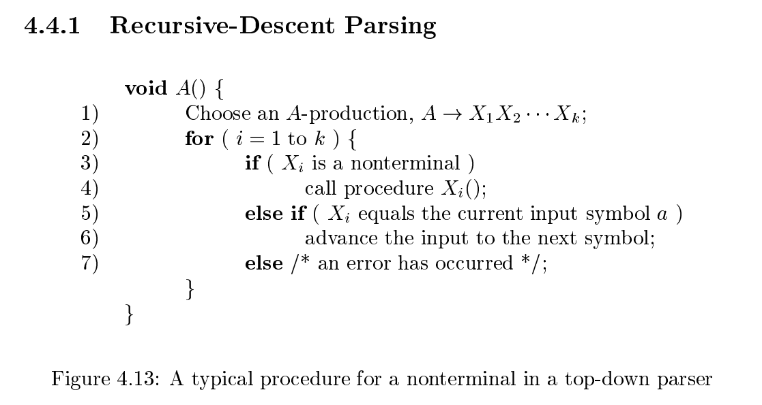
Algorithm for Recursive Descent Parser

Slide 5
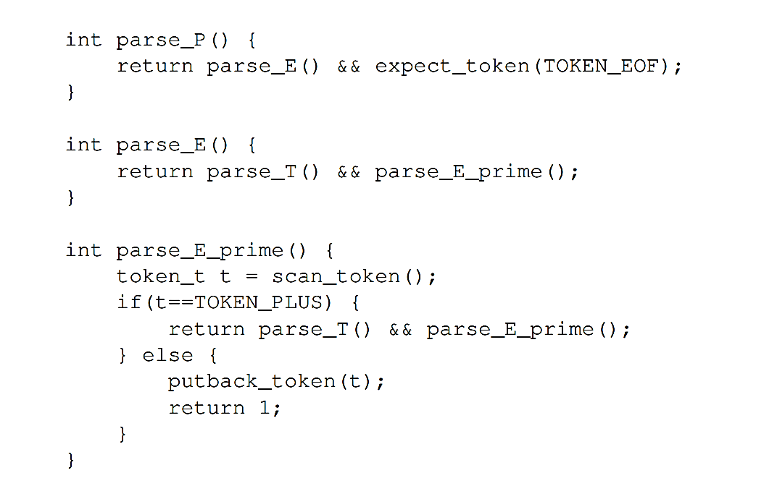
Recursive Descent Parser Pseudocode
E → TE’
E’ → + TE’ / ∈
T → FT’
T’ → x FT’ / ∈
F → (E) / id|num
4+ 9

Slide 6
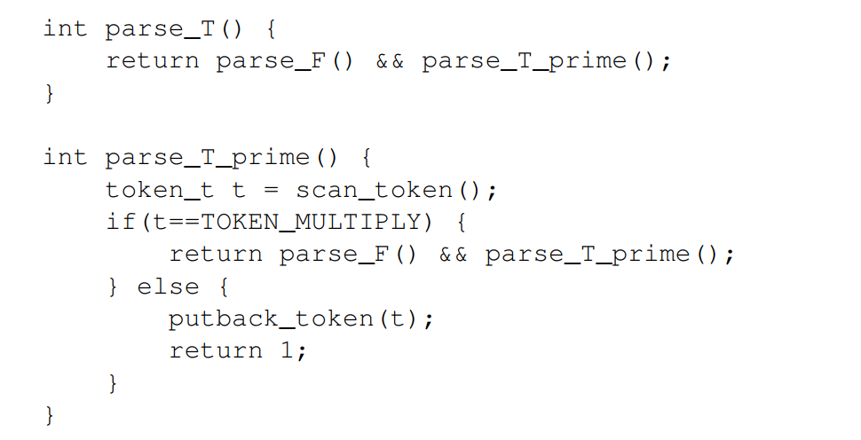
Recursive Descent Parser Pseudocode

Slide 7
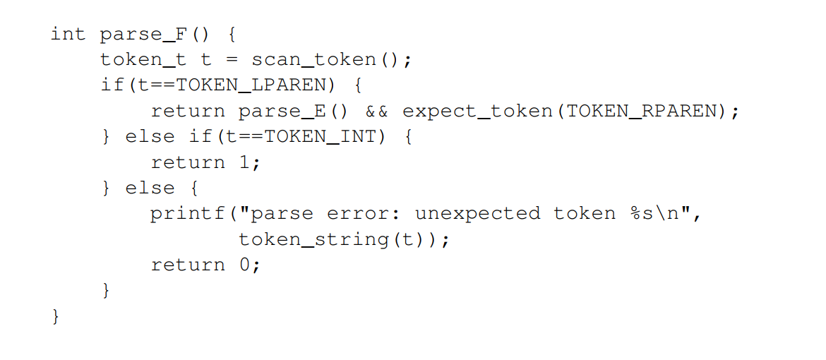
Recursive Descent Parser Pseudocode
E → TE’
E’ → + TE’ / ∈
T → FT’
T’ → x FT’ / ∈
F → (E) / id|num
4+ 9

Slide 8
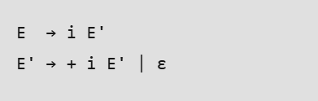
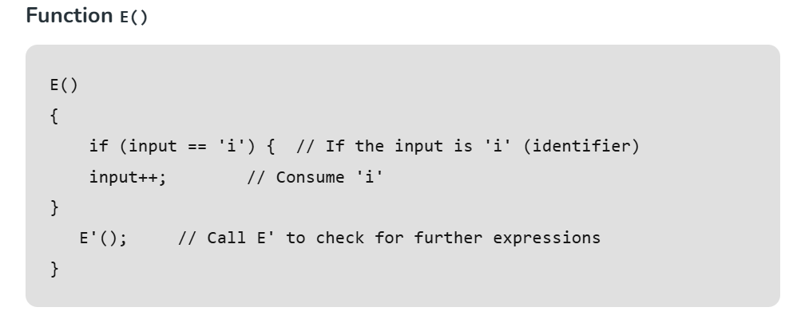
Example (Recursive Descent Grammar)
i+i

Slide 9
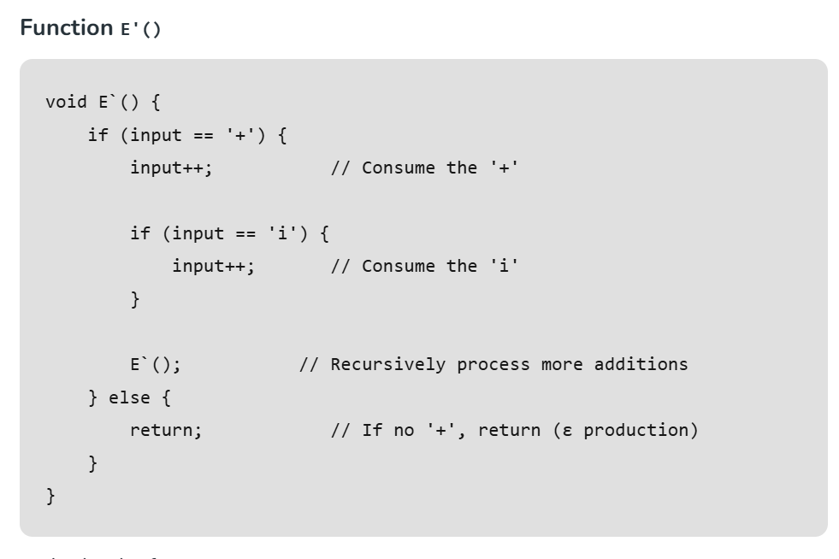

Slide 10
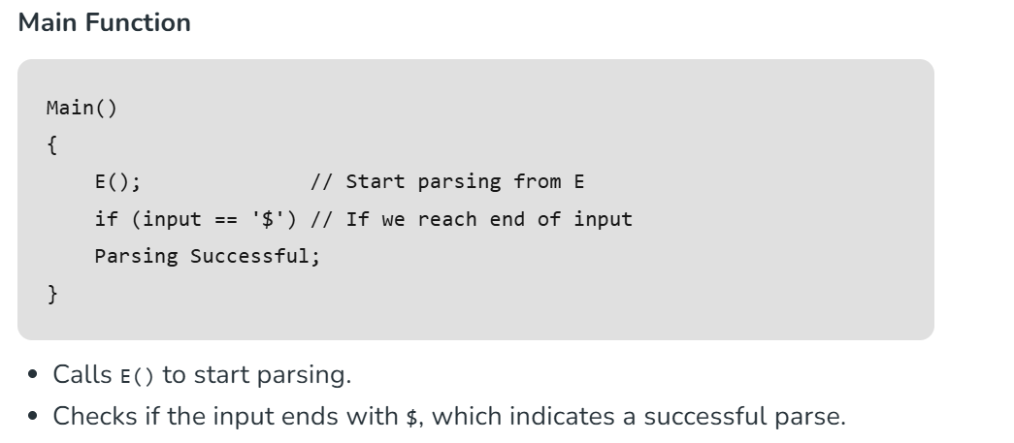

Slide 11
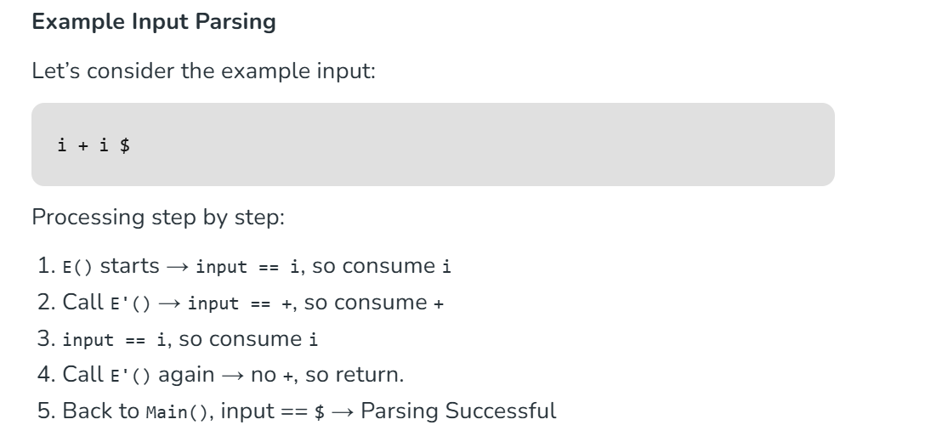

Slide 12
Non-Recursive Descent Parser (Table Driven)/Predictive Parser
This type of parser is more often generated by a parser generator (like yacc or bison).
It uses two main data structures:
An input buffer containing the tokens to be parsed.
A stack (which you manage in your code) that holds grammar symbols (both terminals and non-terminals).
A parsing table (a 2D array) that tells the parser what grammar rule to apply based on the current symbol on the stack and the next input token.
The grammar should be passed by LL(1) grammar

Slide 13
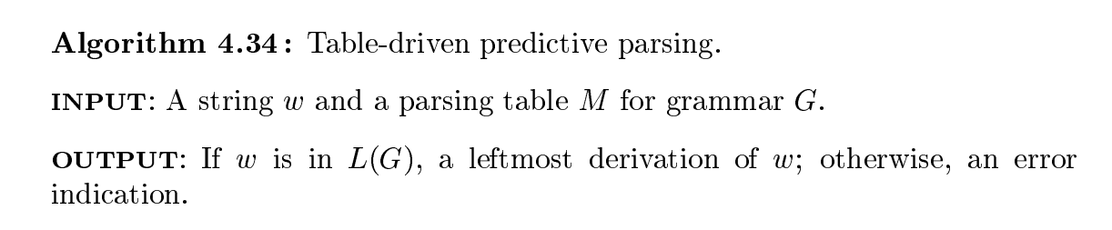

Slide 14
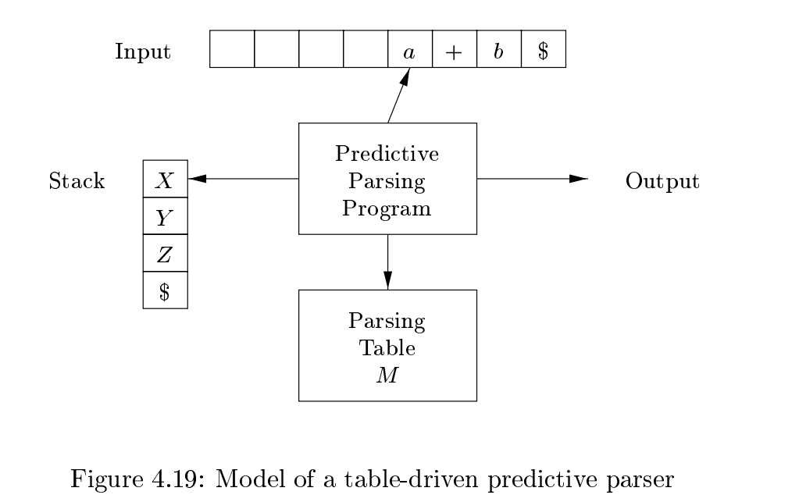

Slide 15
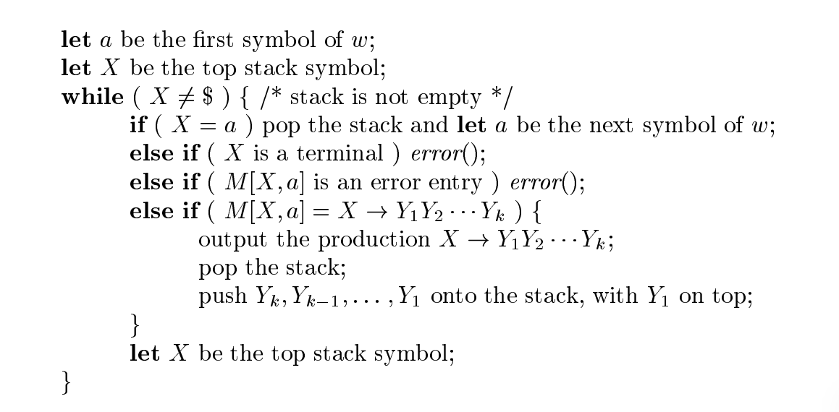
Non-Recursive Descent – Method(function)

Slide 16
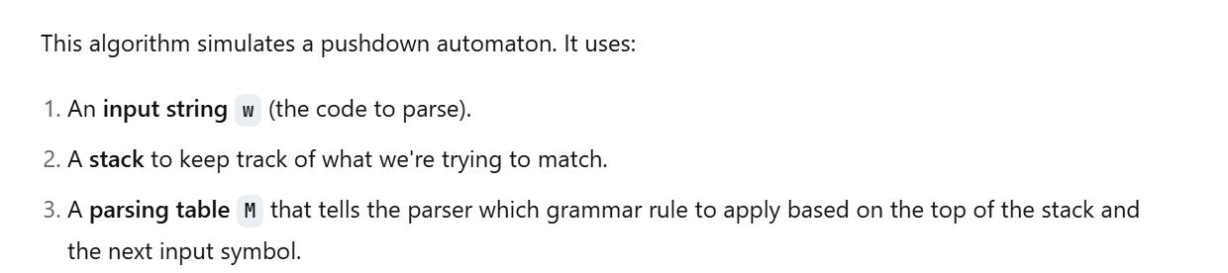

Slide 17
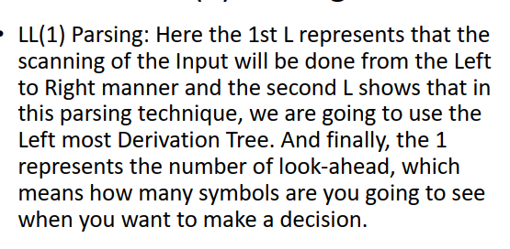
LL(1) Parsing

Slide 18
Essential conditions for LL(1)
The grammar is free from left recursion.
The grammar should not be ambiguous.
The grammar has to be left factored in so that the grammar is deterministic grammar.
Find First() and Follow() of the Grammar
Creating LL(1) Parsing Table

Slide 19
Algorithm to construct LL(1) Parsing Table
Step 1: First check all the essential conditions
mentioned above and go to step 2.
• Step 2: Calculate First() and Follow() for all
non-terminals.
• Step 3: Make a parser table.
• Step 4: Illustrate LL(1) Parse Tree

Slide 20
LL(1) Example 1
Let the grammar
– S' → S
S → xYzS | a
Y → xYz | y
• This grammar is satisfying conditions, Not-Left Recursive, Left Factored,
we will need to find First() and Follow() and then Parse Table

Slide 21
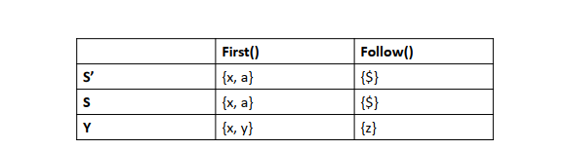
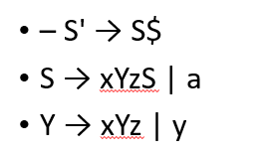
 | x | a | y | z | $
S’ | S’->S | S’->S
S | S->xYzS | S->a
Y | Y->xYz |  | Y->y
Stack | Input | Action
$ | xxyzza$ | Push S’
$S’ | xxyzza$ | Pop S’ and Push its rule in revere order
$S | xxyzza$ | Pop S and Push its rule in reverse order
$SzYx | xxyzza$ | Pop x
$SzY | xyzza$ | POP Y and its push its rule reverse order
$SzzYx | xyzza$ | Pop x
$SzzY | yzza$ | Pop Y and push its rule Y->y
$Szzy | yzza$ | Pop y
$Szz | zza$ | Pop z , Pop z
$S | a$ | Pop s and push a
$a | A$ | Pop a

Slide 22
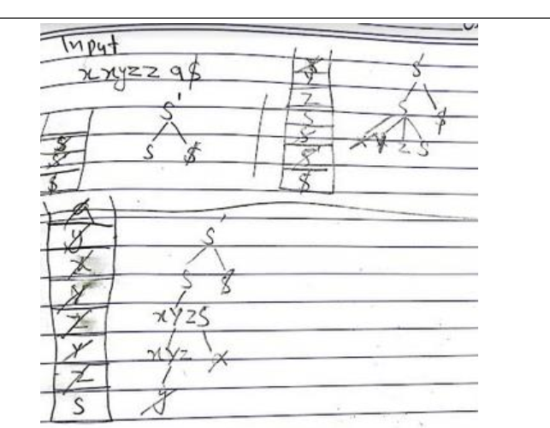

Slide 23
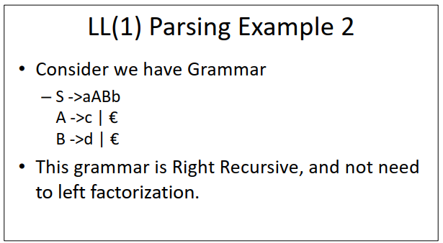

Slide 24
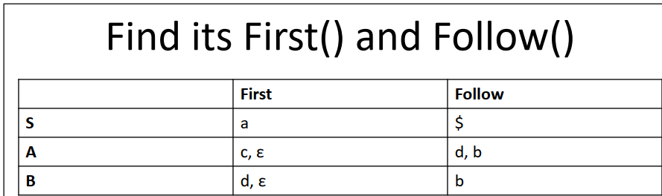
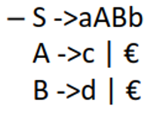
 | a | b | c | d | $
S | S->aABb
A |  | A->E | A->c | A->E
B |  | B->E |  | B->d

Slide 25
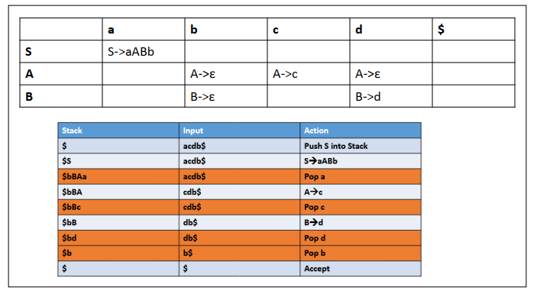

Slide 26
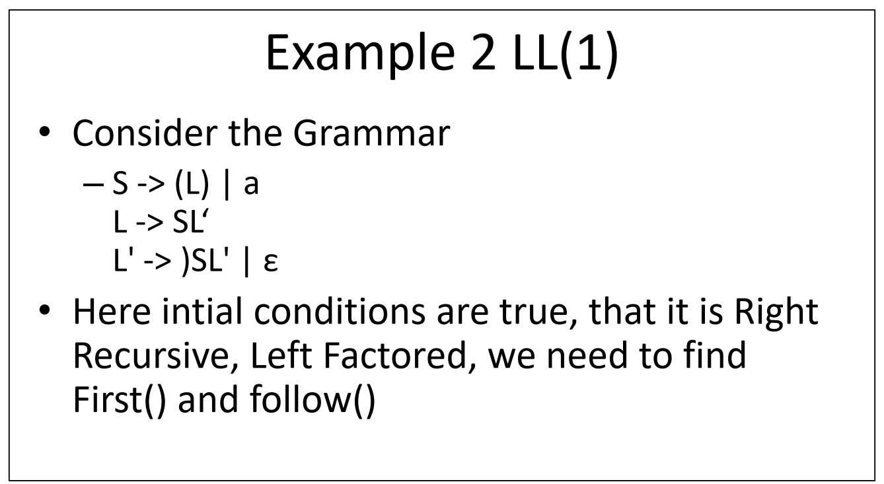

Slide 27
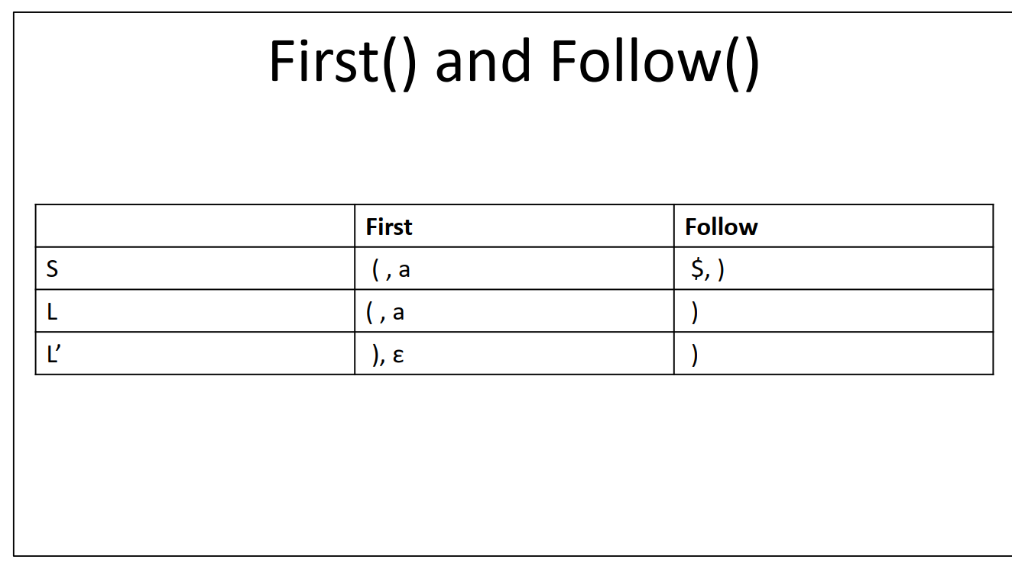

Slide 28
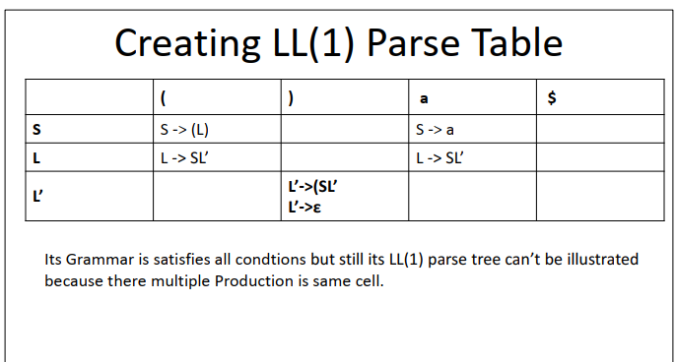

Slide 29
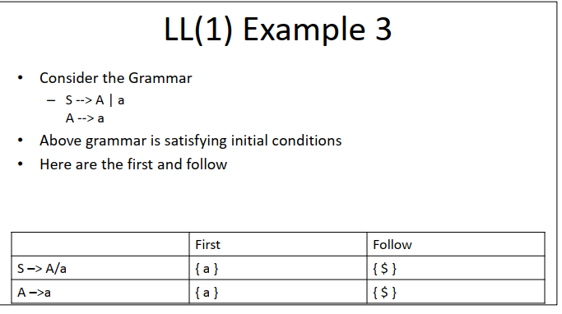

Slide 30
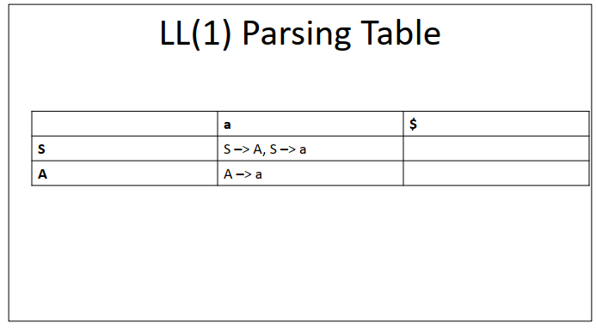

Slide 31
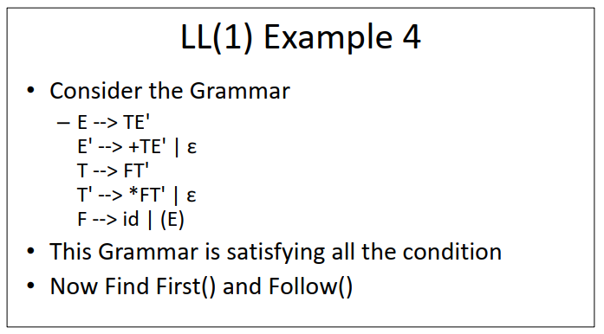

Slide 32
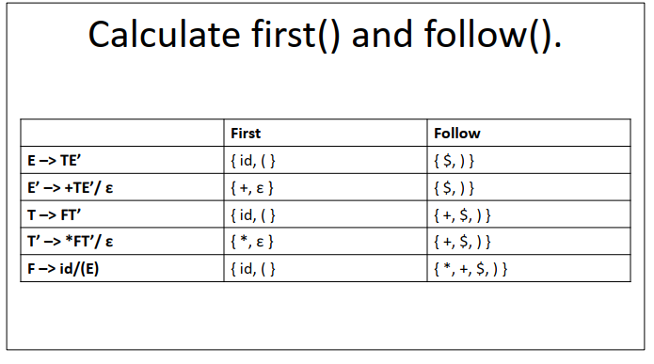

Slide 33
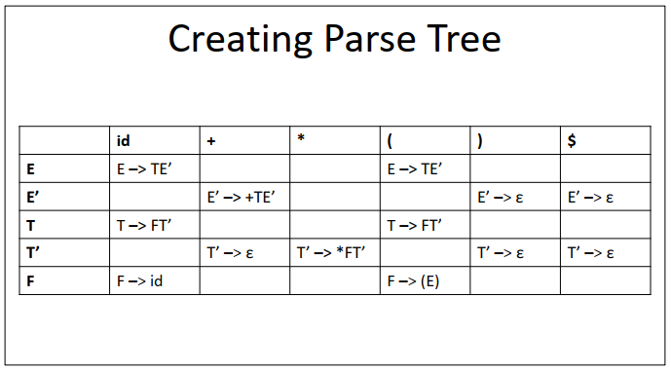

Slide 34
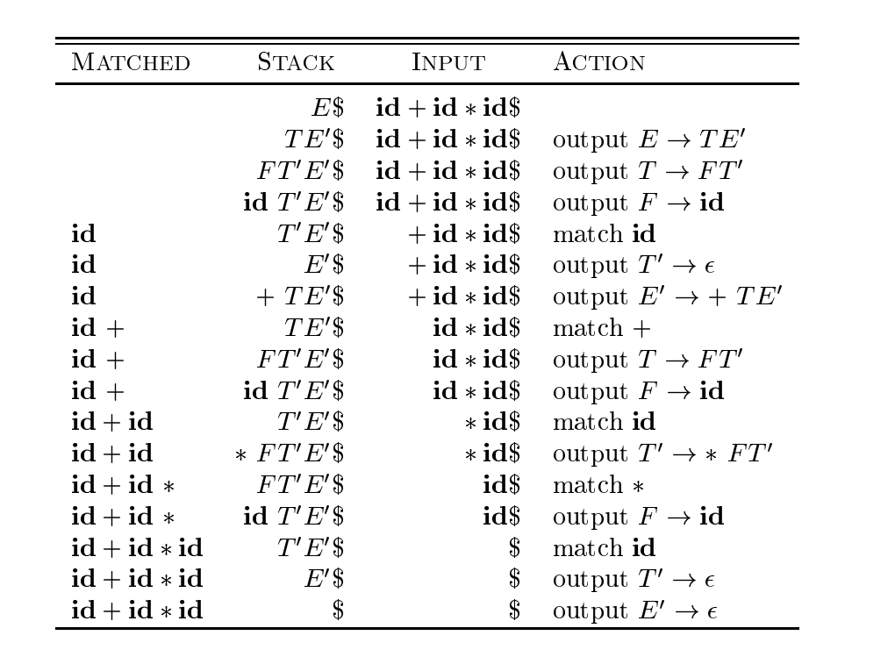

Slide 35
Difference Between Recursive & Non-Recursive. (Top Down Parsers)
Recursive Predictive Descent Parser | Non-Recursive Predictive Descent Parser
It is a technique which may or may not require backtracking process. | It is a technique that does not require any kind of backtracking.
It uses procedures for every non-terminal entity to parse strings. | It finds out productions to use by replacing input string.
It is built from a set of mutually recursive procedures where each procedure implements one of non-terminal s of grammar. | It is a type of top-down approach, which is also a type of recursive parsing that does not uses technique of backtracking.
It contains several small functions one for each non- terminals in grammar. | It uses a look ahead pointer which points to next input symbols to make it parser back tracking free, it puts some constraints on grammar.
It accepts all kinds of grammars. | It accepts LL(k) grammar type of grammar

Slide 36
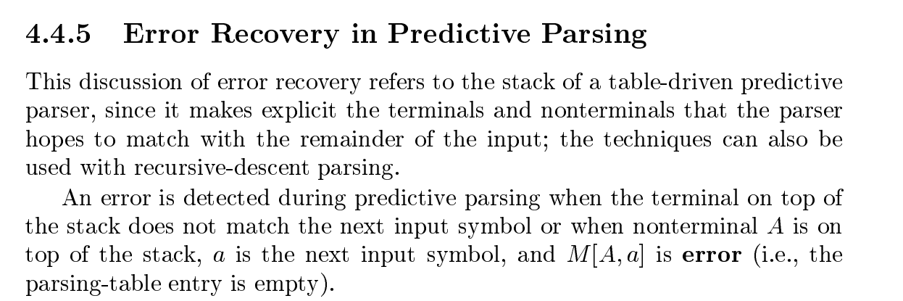

Slide 37
Two Types of Errors Handling in Predictive Parsing
Panic Mode
Phrase Mode

Slide 38
Panic Mode
Panic mode is the skipping over symbols on the input until a token in a selected set of synchronizing tokens appears.
efectiveness depends on the choice of synchronizing set.
The sets should be chosen so that the parser recovers quickly from errors that are likely to occurin practice. Some heuristics are as follows:
Pop Non-terminal from the Stack
Discard/remove terminal from the string

Slide 39
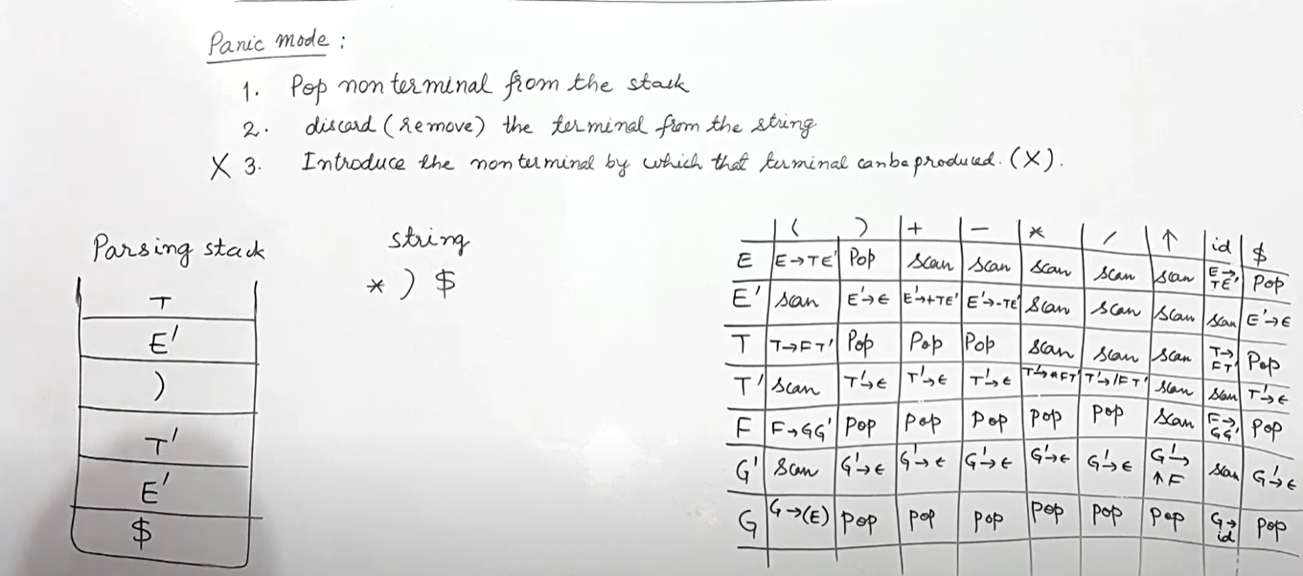

Slide 40
Reference:
Compilers: Principles, Techniques, and Tools 2nd Edition by Alfred Aho , Jeffrey Ullman, Ravi Sethi, Monica Lam
Introduction to Compilers and Language Design | Second Edition | Prof. Douglas Thain - University of Notre Dame

